Slide 1

Build a Net Zero Social Hub with us
Daniel, Mattia, Philipp, Raphaël, Ştefan
Notes:
philpp

Slide 2
What is a Net Zero Building?
Emissions Produced = Emissions Removed
Materials & Construction
Daily Energy Use
Whole-Life &
Deconstruction
Notes:
philipp

Slide 3
8 phases of building our Net Zero Social Hub
Notes:
Philipp
We present

Slide 4

Phase 1 — Building Site Preparation & Terraforming
Brownfield Regeneration
re-use already used land. Don’t waste anymore green space
Electric Machinery
If possible, avoid fossil fueled machinery
Minimizing Soil Transport
By re-using sealed land, we could minimize the soil transport
Notes:
philipp

Slide 5



Phase 2 — The Foundation
Traditional Concrete = High CO₂
Our Solution:
Steel ground Screws
Low-Carbon Concrete (cement-free concrete)
Recycled Steel Reinforcement
Notes:
Daniel

Slide 6
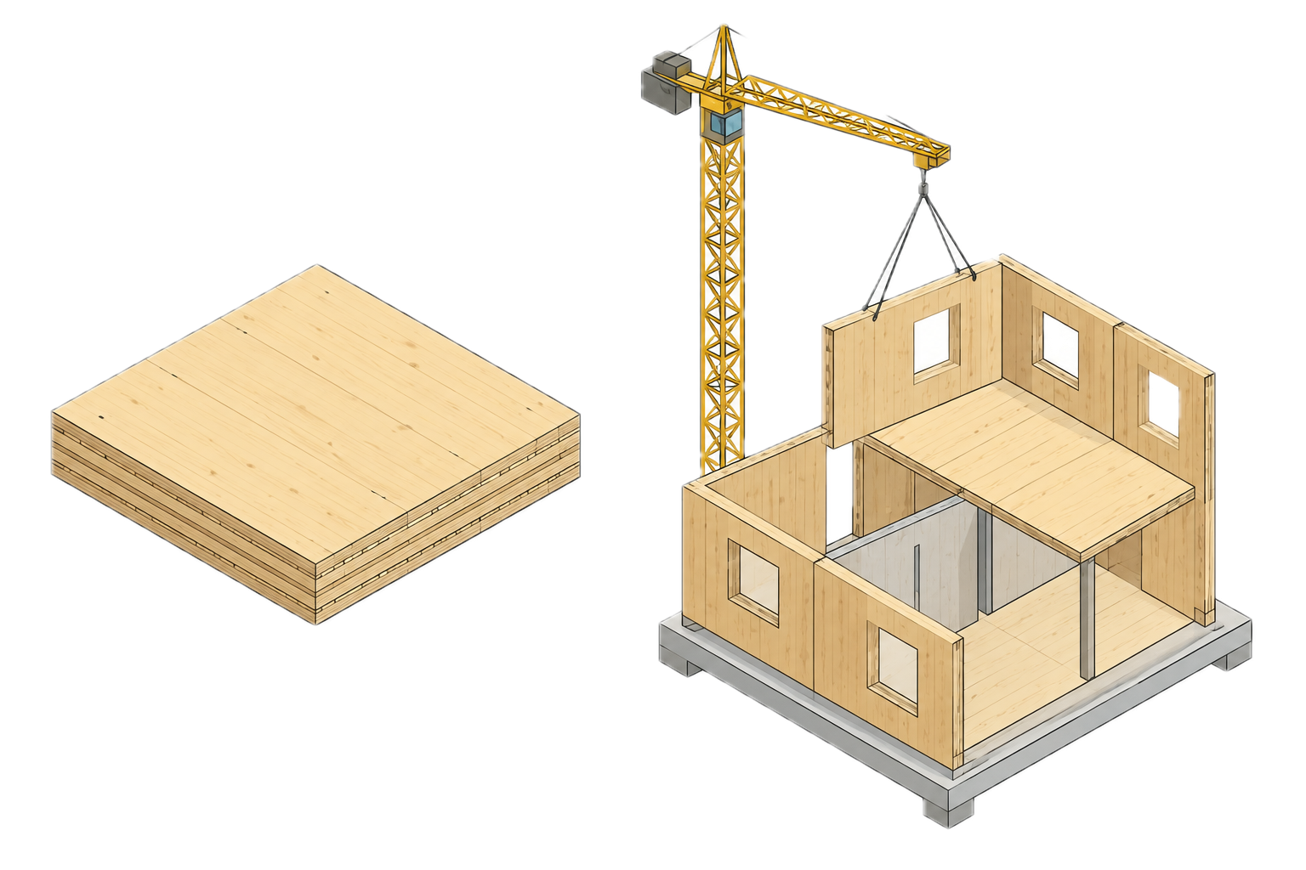
Phase 3 — Structural Frame
Cross-Laminated Timber (CLT)
Utilizing modular, prefabricated, or
demountable cassettes and bolted connections
Used CLT will promote Carbon sequestration (CLT stores C0₂)
Notes:
daniel

Slide 7
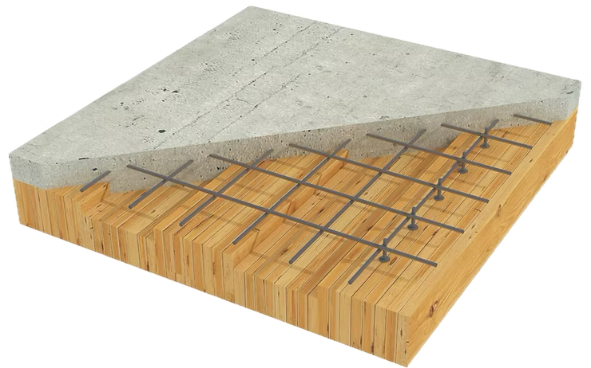
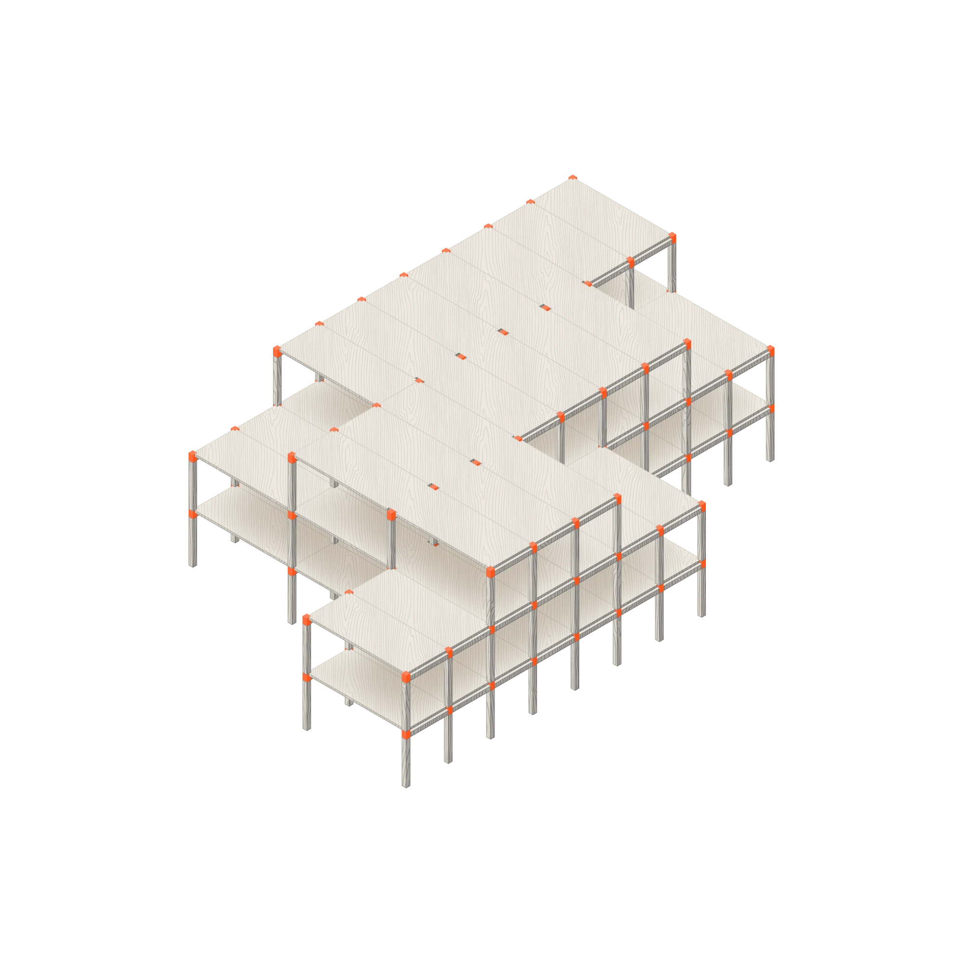
Phase 4 — Floor Systems
Timber-Concrete Composite Floors
-> less harmful
Modular Construction
-> no need for heavy equipment on site
Less Waste, Faster Build
-> no adhesive = less water & faster
Notes:
stefan

Slide 8
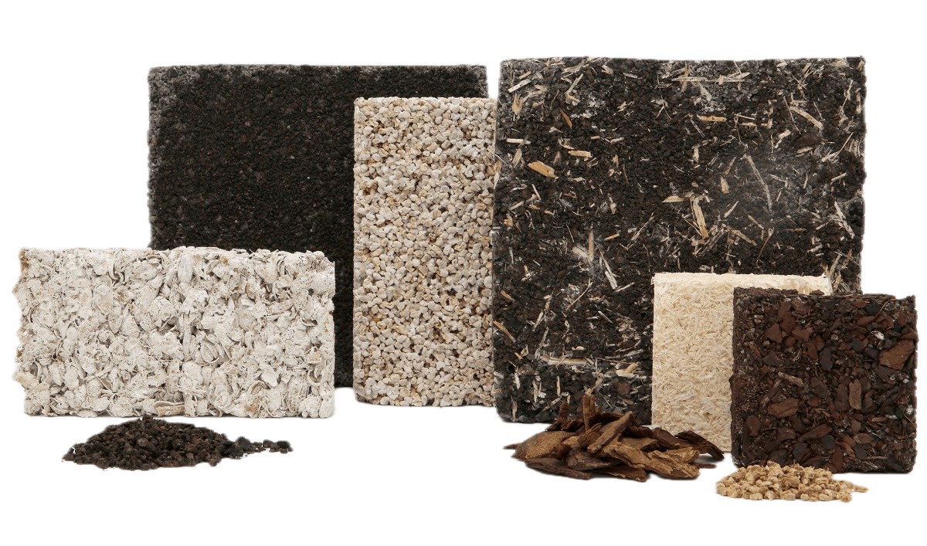
Phase 5 — Wall Insulation
Passive House Standards
Superinsulation
Airtightness
Thermal Bridge-Free Design
Bio-based Insulation (Hemp, Cellulose)
Notes:
stefan

Slide 9
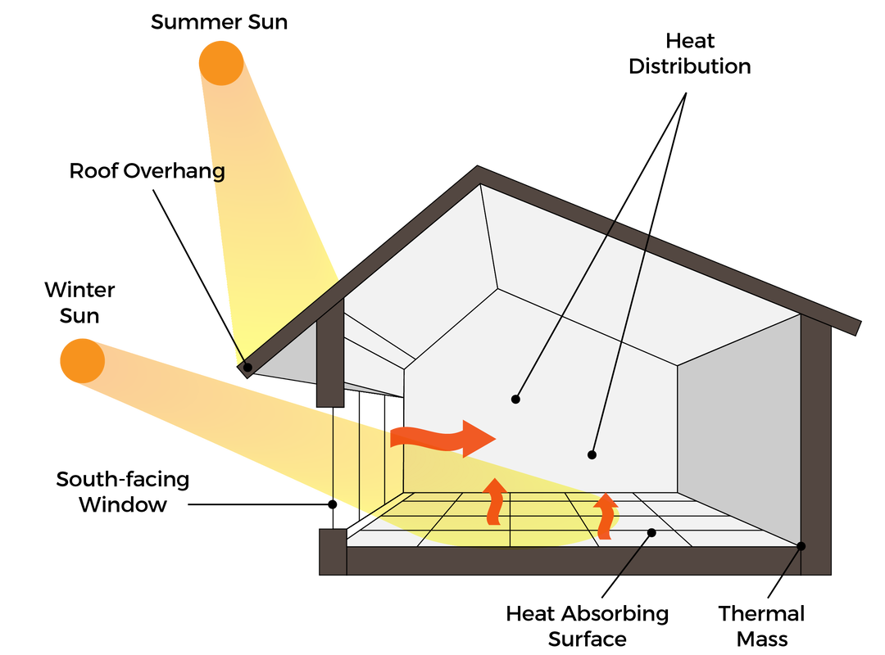
Phase 6 — Windows & Glazing
Well isolated windows
High-Performance Double & Triple Glazing
Argon Gas Fillings
Smart placement of openings
Shade off Sun in Summer
Use Sun as Heater in Winter
Notes:
RAPHI

Slide 10
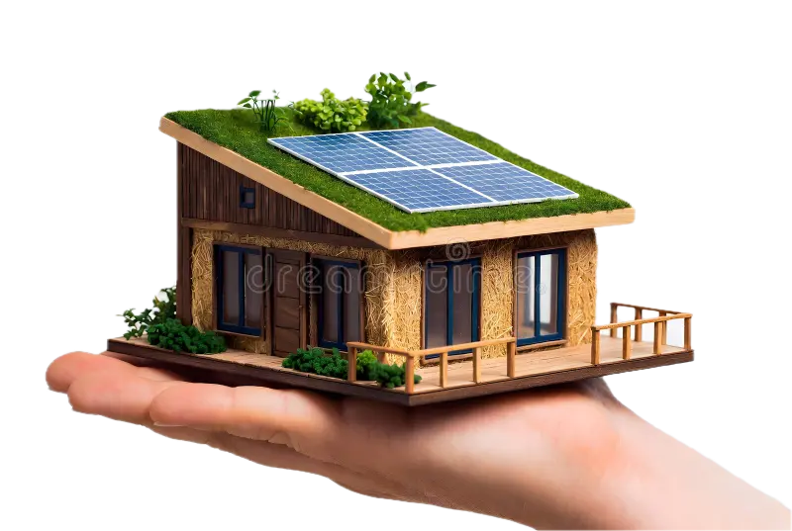
Phase 7 — The Roof
Green Roof System
Natural Cooling & Insulation
Rainwater Management
Rooftop Solar PV Array
Building-Integrated Photovoltaics (BIPV)
Battery Storage System
Notes:
RAPHI

Slide 11
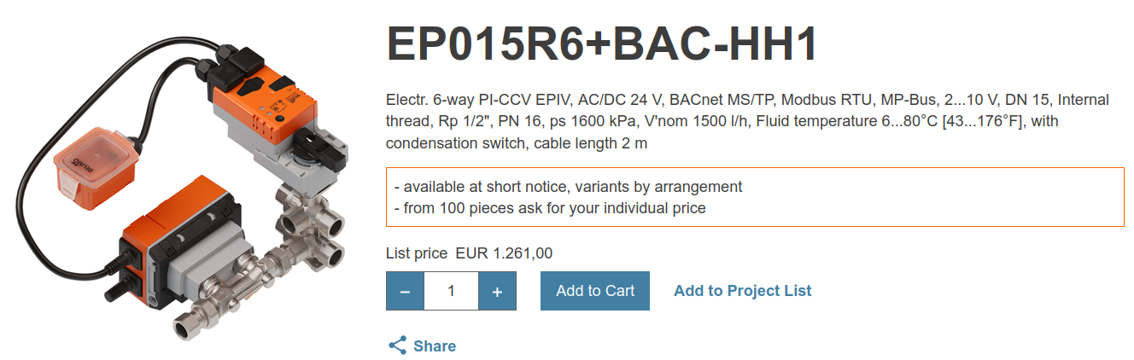
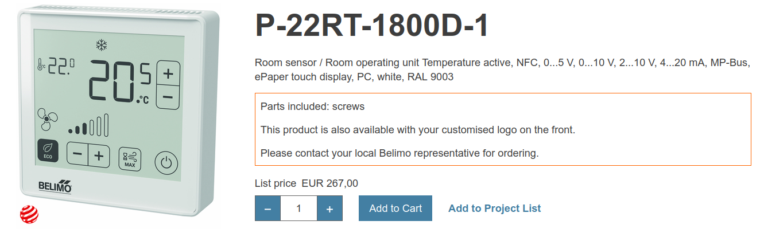
DAUERWERBESENDUNG
Phase 8 — Heating & Cooling
HVAC Design Process
Load Calculations: The Foundation of Efficient Design
System Selection: Choosing the Right Technology
Zoning and Distribution Design (40% less energy)
Control System Integration (Building Management System -> KNX)
Compliance and Performance Planning
Notes:
mattia

Slide 12
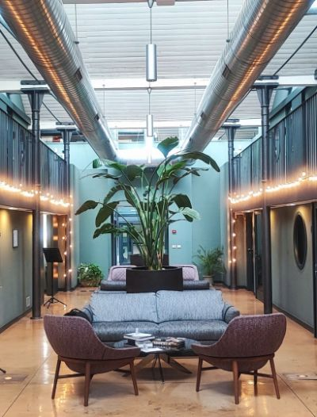
DAUERWERBESENDUNG
Phase 8 — Heating & Cooling
BELIMO RetroFIT+
Project
Casta Diva Group, Milano. Officebuilding 1950s
Challenge
Two independent expansion units serving a two-story duct loop system caused temperature deviations
Solution
RetroFIT+ project with Belimo ZoneEase™ actuators. Room-by-room VAV implementation for improved comfort control
Result
53% reduction in energy consumption, more stable room temperatures, monitoring and UX
Notes:
mattia

Slide 13
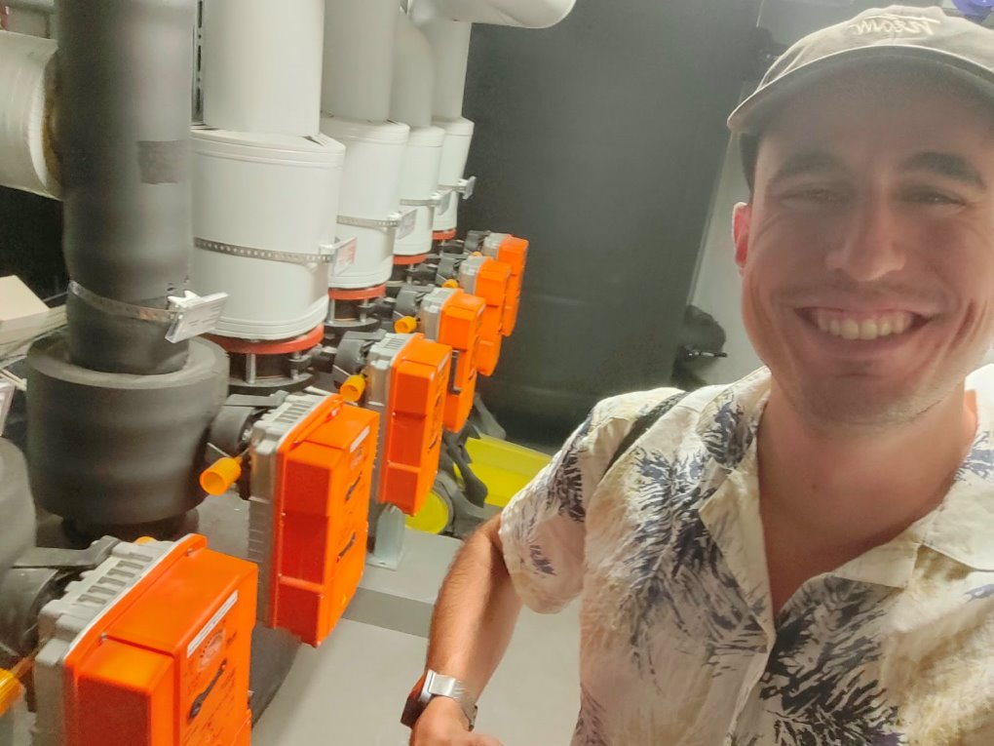
Challenges
High initial costs
Overheating in summer
Balancing daylight and energy performance
Natural ventilation vs. airtightness
Energy production depends on the climate
Design complexity
Notes:
mattia

Slide 14
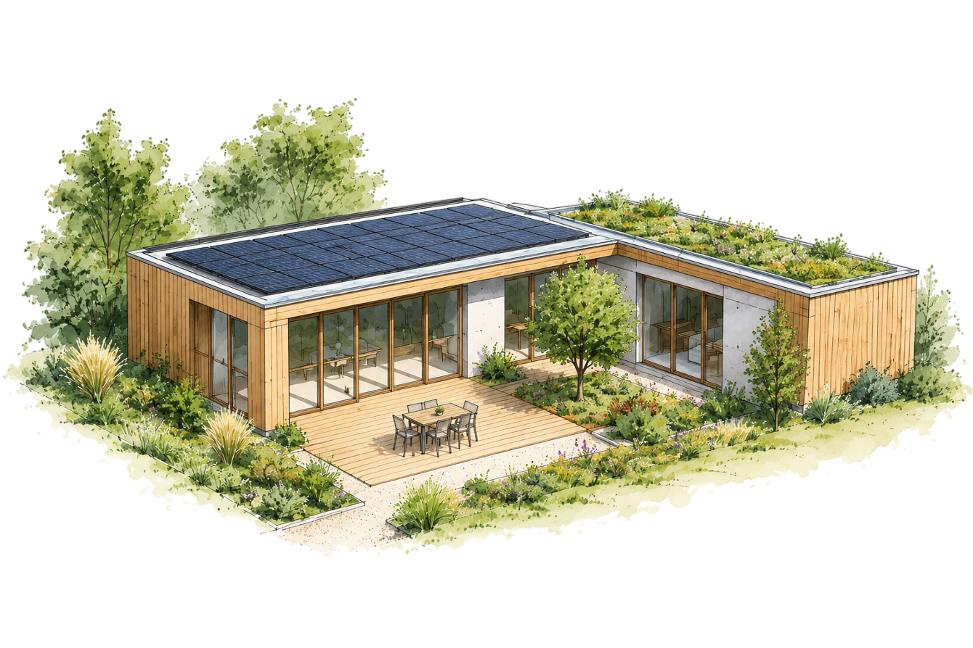
Conclusion
Notes:
Daniel

Slide 15
Net-zero starts with the design of the building, not with photovoltaic panels on the roof.
Notes:
daniel

Slide 16
QUIZ
Notes:
mattia

Slide 17

Thank you for your attention
Notes:
mattia

